Slide 1
.NET 6
Long Term Evolution ?
Leszek Kowalski Michał Bryłka Capgemini

Slide 2


Who are we ?
Leszek
Team lead / soft dev
Michał
Tech lead / soft dev

Slide 3
Agenda
NET 6
API improvements
Performance improvements
C# 10.0
More New features
Developer Toolbelt improvements
Demo
Discussion Panel

Slide 4
API Improvements
Collections
EnsureCapacity for List, Stack, Queue (but not Collection…)
CollectionsMarshal.AsSpan
CollectionsMarshal.GetValueRefOrNullRef
Unsafe.IsNullRef
StringComparer
IsWellKnownOrdinalComparer(comparer, out bool ignoreCase);
IsWellKnownCultureAwareComparer(comparer, out CompareInfo compareInfo, out CompareOptions compareOptions);

Slide 5
API Improvements
PriorityQueue
var shopQueue = new PriorityQueue<string, Job>();
shopQueue.Enqueue("Michał", Job.Developer);
shopQueue.Enqueue("Wojciech", Job.Physicist);
shopQueue.Enqueue("Jarosław", Job.Politician);
while (shopQueue.TryDequeue(out string? name, out Job _))
Console.WriteLine($"Serve now {name}");
public enum Job { Physicist, Developer, Politician }
// Serve now Wojciech
// Serve now Michał
// Serve now Jarosław

Slide 6
API Improvements
File and I/O
public FileStream(SafeFileHandle handle, FileAccess access, int bufferSize, bool isAsync)
Changes to FileStream.Position
Not serialized to OS
Updated after async operations
Preallocation size and options (RandomAccess, DeleteOnClose, …) specification sealed record FileStreamOptions(/*..., */ FileOptions Options, int BufferSize = 4096, long PreallocationSize);
Vectored (scatter/gather) I/O
Atomicity
Concatenated output
Efficiency
GetLength: faster 33 Times
SeekForward/SeekBackward: 10-100 times faster
Read/WriteAsync: up to 5 times faster
Read/Write: up to 6 times faster

Slide 7
API Improvements
Native alloc
unsafe
{
int* number = (int*)NativeMemory.Alloc(sizeof(int));
*number = 42;
int* numbers = (int*)NativeMemory.Alloc(2, sizeof(int));
numbers[0] = 42;
numbers[1] = 420;
numbers++;
var n = *numbers;
NativeMemory.Free(number);
NativeMemory.Free(numbers);
}

Slide 8
API Improvements
Async
WaitAsync public Task WaitAsync(CancellationToken cancellationToken); public Task WaitAsync(TimeSpan timeout); public Task WaitAsync(TimeSpan timeout, CancellationToken cancellationToken); TimeSpan instead of int !!!
CancellationTokenSource.TryReset if (!cts.TryReset()) cts = new CancellationTokenSource();

Slide 9
API Improvements
Timer
Timers
System.Threading.Timer, System.Timers.Timer
System.Windows.Forms.Timer, System.Windows.Threading.DispatcherTimer
System.Web.UI.Timer
PeriodicTimer
Single consumer only
Callback-less aproach with async, no sync-over-async
var timer = new PeriodicTimer(TimeSpan.FromSeconds(100));
while (await timer.WaitForNextTickAsync()){ }

Slide 10

Survey
https://s.surveyplanet.com/iusplu0w

Slide 11
Performance improvements
Runtime
Inlining and devirtualization
Sealed types
Eliminate bounds checking if (array.Length >= 4) array[3] = ‚A’;
Folding for System.Math double GetHeight(double longbase, double shortbase, double leftLeg, double rightLeg) { double x = (Math.Pow(rightLeg, 2.0) - Math.Pow(leftLeg, 2.0) + Math.Pow(longbase, 2.0) + Math.Pow(shortbase, 2.0) - 2 * shortbase * longbase) / (2 * (longbase - shortbase)); return Math.Sqrt(Math.Pow(rightLeg, 2.0) - Math.Pow(x, 2.0)); }
Vectorizations (PopCount, fdiv, RotateRight, …)
Lowering (x % 2 == 0, HasFlag, …)

Slide 12
Performance improvements
Framework
Parsing for build-in types from ROS<>
Guid, Version, Enum (?)
Remove allocs
Random,
Environment (GetEnvironmentVariables, ProcessId, ProcessPath),
DateTime (UtcNow, Now)
Enum (IsDefined, GetName, GetNames)
Array (Clear, Fill)
Vectorization
String (Replace, IndexOf)

Slide 13
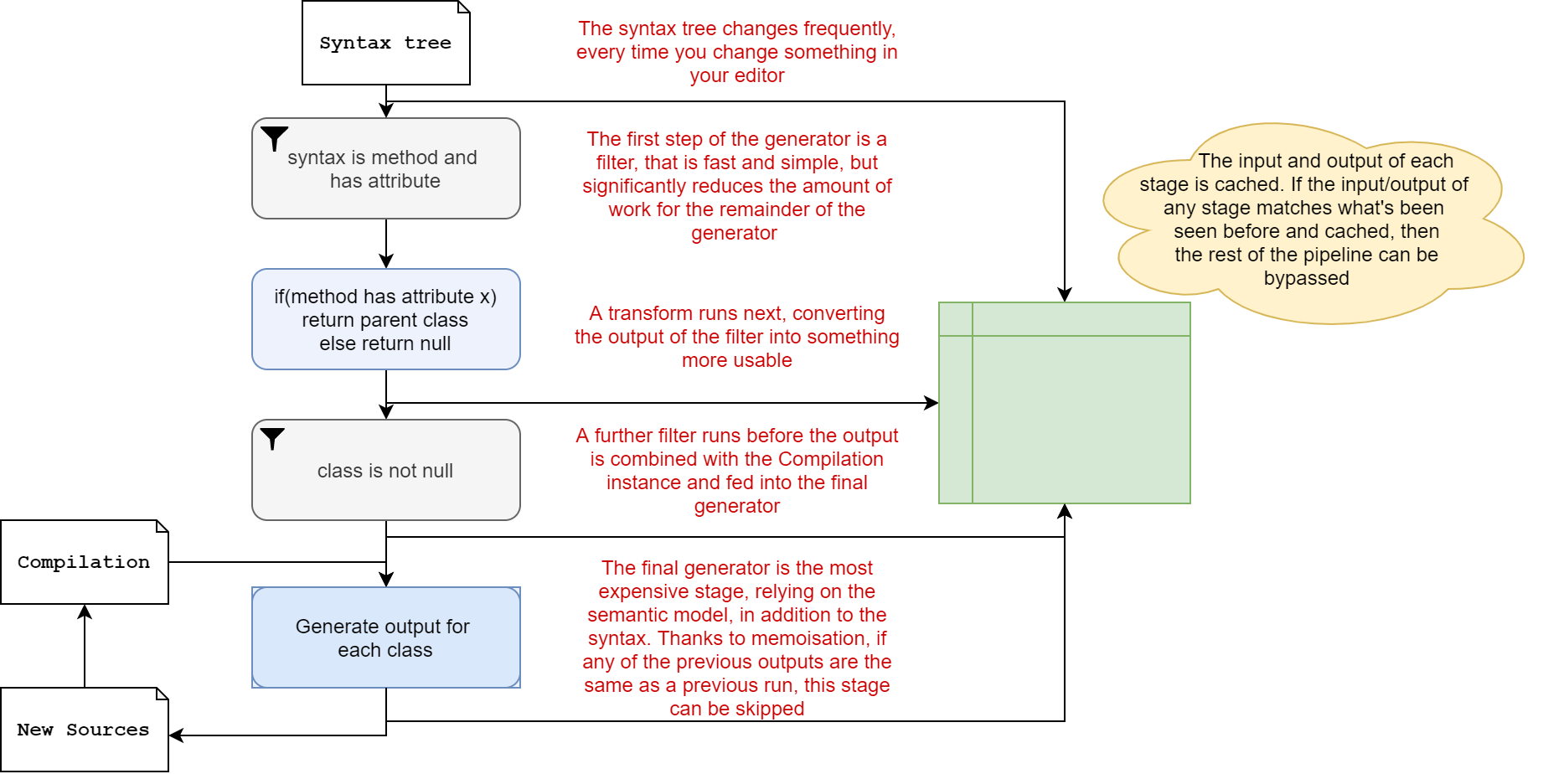
Code generator
Incremental generators
System.Text.Json – allocation issues
Faster approach needed - define pipelines and filters
IIncrementalGenerator

Slide 14
Code generator use
public class TestController { private readonly ILogger<TestController> _logger;
public TestController(ILogger<TestController> logger) => _logger = logger;
[HttpGet("/")] public string Get() { if (_logger.IsEnabled(LogLevel.Information)) _logger.LogInformation("Writing hello world response");
return "Hello world!"; } }

Slide 15
Code generator use
class TestController {
private static readonly Action<ILogger, Person, Exception?> __LogHelloWorldCallback
= LoggerMessage.Define<Person>(
LogLevel.Information,
new EventId(0, nameof(LogHelloWorld)),
"Writing hello world response to {Person}");
void LogHelloWorld(Person person)
{
__LogHelloWorldCallback(_logger, person, null);
}
}

Slide 16
Code generator use
public partial class TestController { [LoggerMessage(0, LogLevel.Information, "Writing hello world response to {Person}")] partial void LogHelloWorld(Person person); }
OR Static: [LoggerMessage(Message = "Writing hello world response to {Person}")] partial void LogHelloWorld(LogLevel logLevel, Person person);
dynamic log levels are not compatible with LoggerMessage.Define() ☹

Slide 17
Code generator use
EventSource gen
[EventSource(Guid = "49592C0F-5A05-516D-AA4B-A64E02026C89", Name = "System.Runtime")]
[EventSourceAutoGenerateAttribute]
internal sealed partial class RuntimeEventSource : EventSource
{
}

Slide 18
Code generator use
System.Text.Json gen
record Animal(string? Name, AnimalKind Kind, AnimalFood Food);
[JsonSerializable(typeof(Animal))] partial class MyJsonContext : JsonSerializerContext { }
public static void TestJsonGen() { var animal = new Animal("Lion", AnimalKind.Mammal, AnimalFood.Carnivorous); byte[] utf8Json = JsonSerializer.SerializeToUtf8Bytes(animal, context); var newAnimal = JsonSerializer.Deserialize(utf8Json, context); }

Slide 19
Code gen workshop
Join us on 16th of December

Slide 20
Caller Argument Expression
aka. FluentAssertions vNext
static void Assert(bool condition,
[CallerArgumentExpression("condition")] string message = null)
=> Debug.Assert(condition, message);
May only be used on parameters with default values
Multiple parameters marked with CallerArgumentExpression are permitted
For invalid parameter names compiler will pass in an empty string
Sadly no nameof support

Slide 21


Lambda enhancements
var f1 = string () => default; var f2 = ref int (ref int x) => ref x; var f3 = void () => { }; var f4 = async (int i) => i;
Method(int (i) => i); static void Method<T>(Func<T, T> f) { }
Func<string,int> func = int.Parse; MyParser mp = func; public delegate int MyParser(string arg);

Slide 22

Lambda enhancements

Slide 23
Monoid and Groups aka Generic Math
public interface IParseable<TSelf> where TSelf : IParseable<TSelf> { static abstract TSelf Parse(string s, IFormatProvider? provider);
static abstract bool TryParse([NotNullWhen(true)] string? s, IFormatProvider? provider, out TSelf result); }
public readonly struct Guid : IParseable<Guid> { public static Guid Parse(string s, IFormatProvider? provider) { /* Implementation */ }
public static bool TryParse([NotNullWhen(true)] string? s, IFormatProvider? provider, out Guid result) { /* Implementation */ }
}

Slide 24
VS 2022
64 bit
Sleek GUI
Hot Reload (including HTML/JS/CSS, WinForms + WPF)
3 times faster Find & Replace
Sub-conditional breakpoints
Support for incremental codegen
Improved IntelliCode
Run tests on WSL
Github Actions templates

Slide 25
Source Build
Linux Standard – Components built by platform toolchain
Building .NET SDK purely with open source toolchain
Microsoft binary build of .NET SDK
Pure Open Source build of .NET SDK
Provably Open Source .NET SDK
Reproductible builds

Slide 26
Open Telemetry Metrics API
OpenTelemetry API
Observability – Logs, Traces, Metrics
System.Diagnostics.Metrics
Counter, Histogram, Gauge
MeterListener
Exporters – Prometheus, Jaeger, Zipkin, Console

Slide 27
Dotnet Monitor
Cross platform diagnostic tool
Microservice with HTTP endpoint
/processes
/process
/dump
/gcdump
/trace
/logs
/metrics

Slide 28
Demo

Slide 29
Summary
https://docs.microsoft.com/en-us/dotnet/core/compatibility/6.0

Slide 30
The end
Thank you for your attention

